Slide 1
Neural NotWorks
Automated Detection of Cardiac Diseases
Members
Tirth Patel
Perin Modi
Vinit Chokshi
Shrey Patel
Karan Patel

Slide 2
Abstract
The project revolves around analyzing electrocardiogram (ECG) data to predict the presence of cardiac diseases. The dataset consists of 827 records, each containing 4096 samples (cycles) of 12 leads of ECG. The primary objective is to study these leads and develop a predictive model to determine if a patient exhibits symptoms indicative of cardiac diseases.
The data is stored in .hdf5 files in a standardized format. Given a .hdf5 file containing ECG data, the goal is to predict whether the patient has a high likelihood of having cardiac diseases. This abstract provides an overview of the project's scope and aims, emphasizing the importance of utilizing ECG data for early detection and intervention in cardiac health.

Slide 3
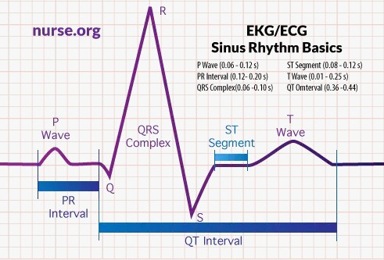
ECG Decoded

Slide 4
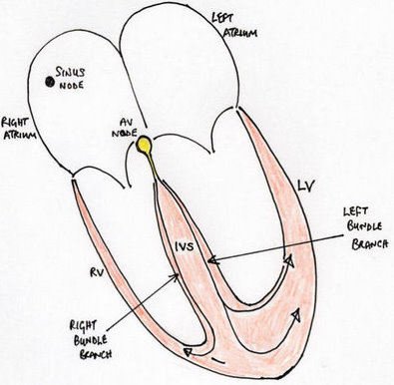
How ECG is recorded
The wave of electrical depolarisation spreads from the atria down though the IVS to the ventricles. So the direction of this depolarisation is usually from the superior to the inferior aspect of the heart. The direction of the wave of depolarisation is normally towards the left due to the leftward orientation of the heart in the chest and the greater muscle mass of the left ventricle than the right. This overall direction of travel of the electrical depolarisation through the heart is known as the electrical axis.
A fundamental principle of ECG recording is that when the wave of depolarisation travels toward a recording lead this results in a positive or upward deflection. When it travels away from a recording lead this results in a negative or downward deflection.

Slide 5
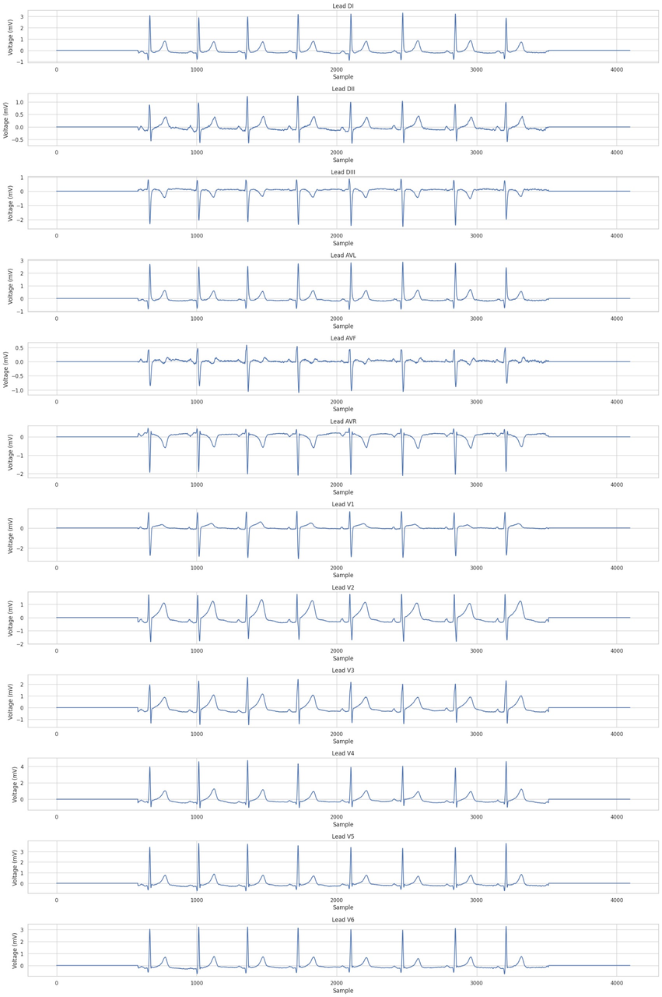
12 Leads of 1st record

Slide 6
After thoroughtly studying data provided we came to a observation that all the waves that don’t show uniformity leads to a high chance of blockage and abnormalities
The following feaures are extracted from the ECG
Rhythm
Rate
Axis
PR interval
Q wave
QRS complex
QT interval
ST interval
T wave
hr mean
hr standard deviation
hrv mean
hrv standard deviation
HR: Heart Rate
HRV: Heart Rate Variablility
P,Q,R,S,T correspond from ECG

Slide 7
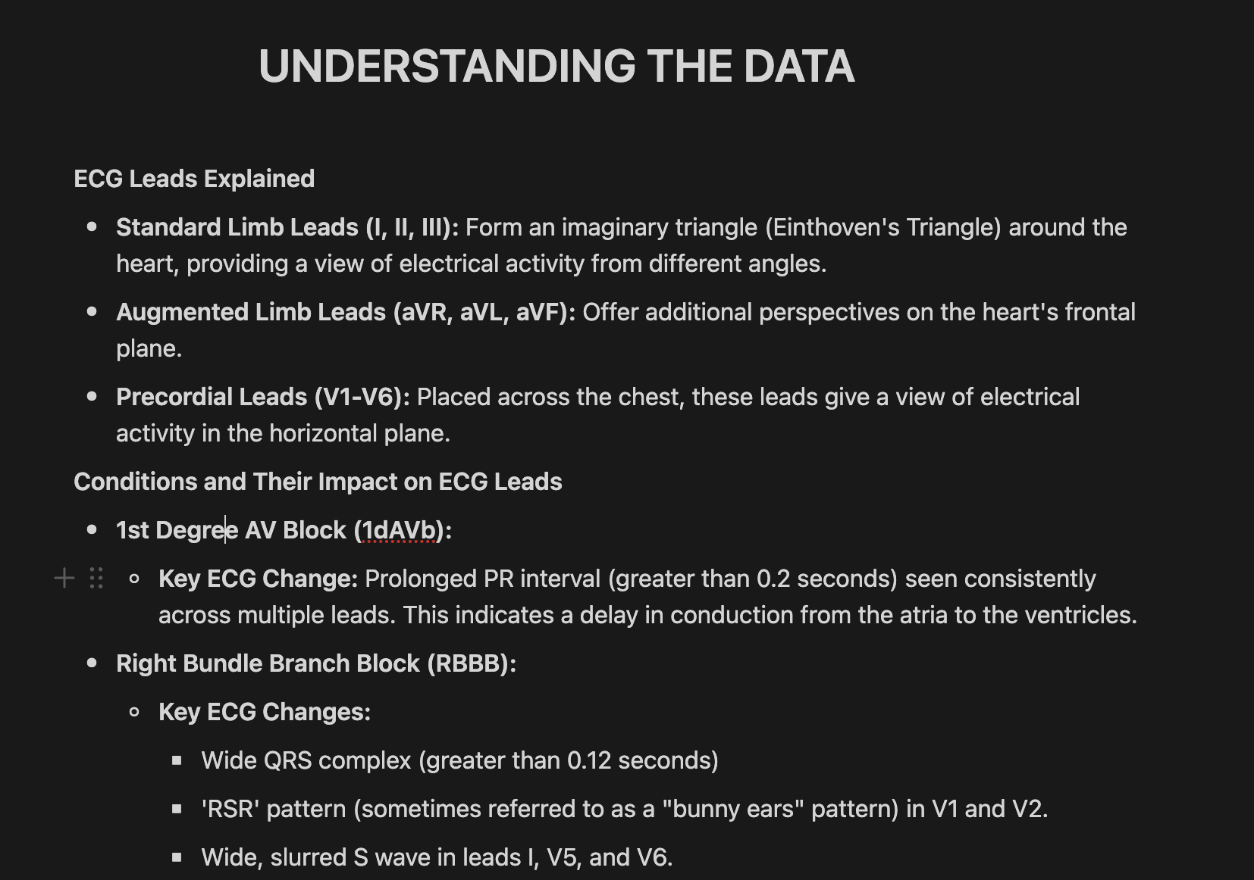

Slide 8
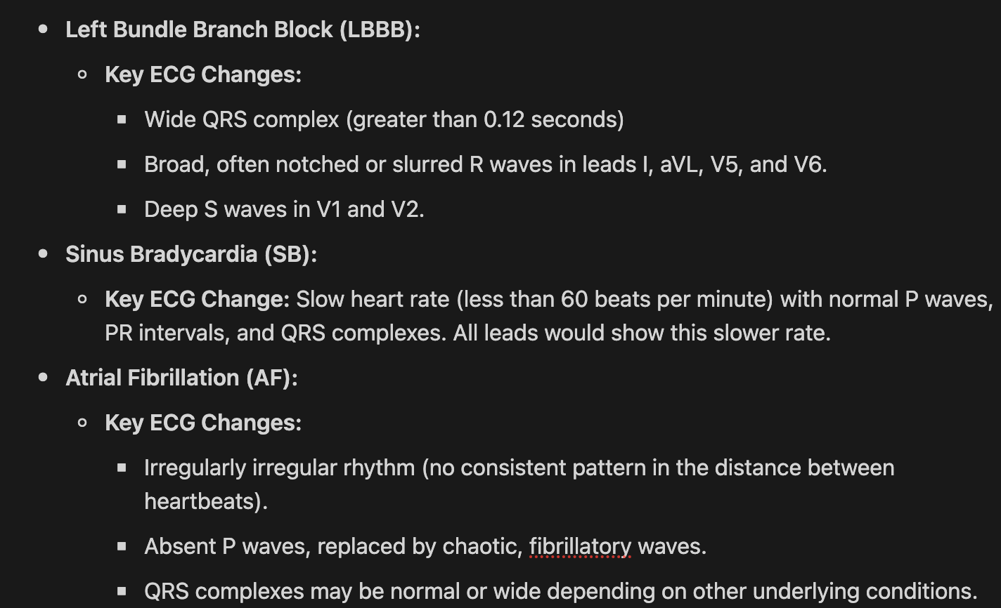

Slide 9
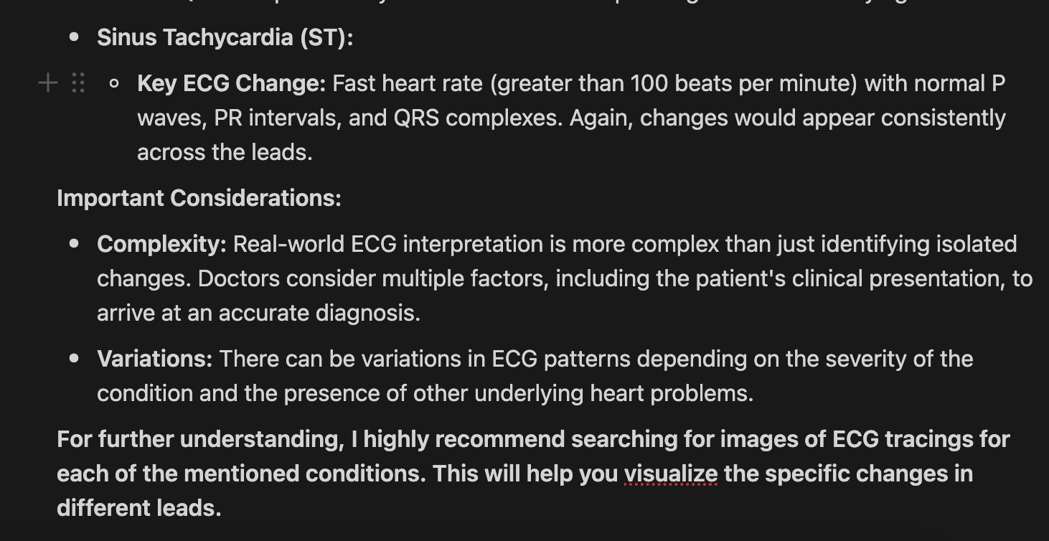

Slide 10
These all observations were found by following different Research Papers. And from that we arrived at conclusions that fluctuations in the ECG corresponds to a high chance of blockage or abnormalities in heart.
We have extracted all these features from the ECG and trained our model accordingly.

Slide 11
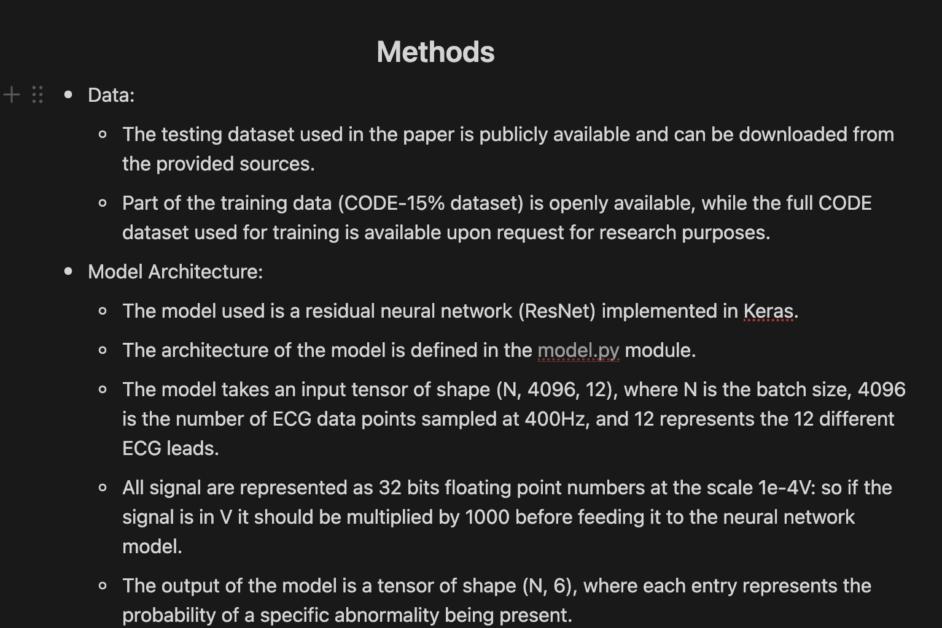

Slide 12
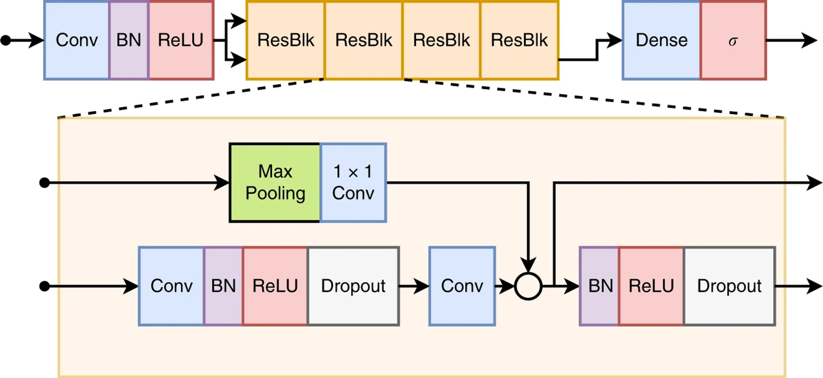
Model Architecture

Slide 13
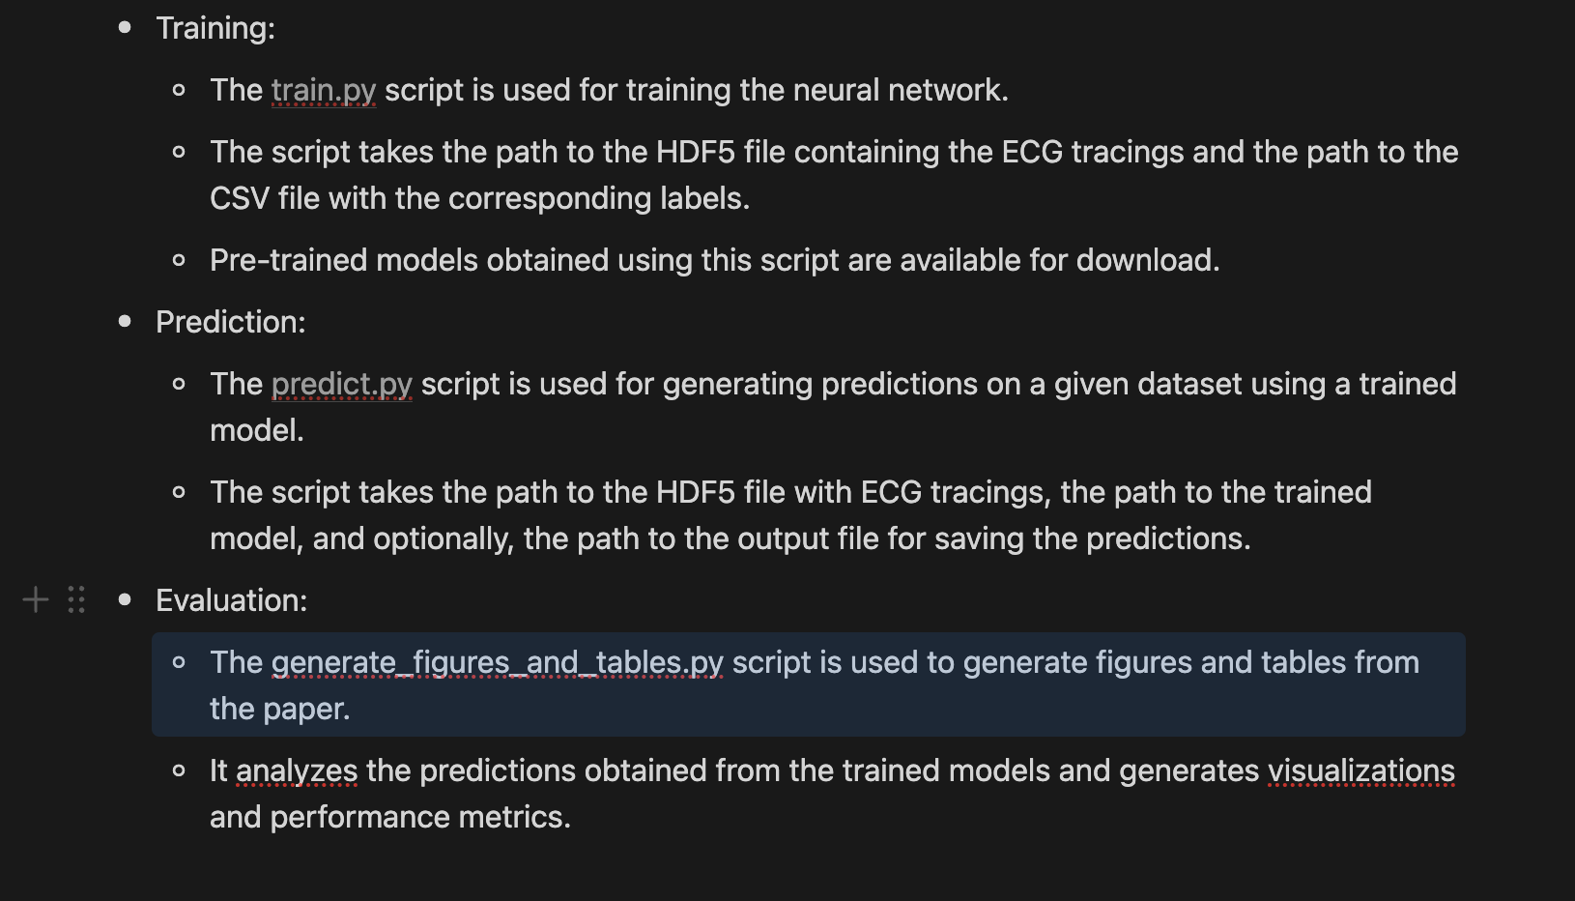

Slide 14
Results
Test Accuracy: 84.3375%

Slide 15
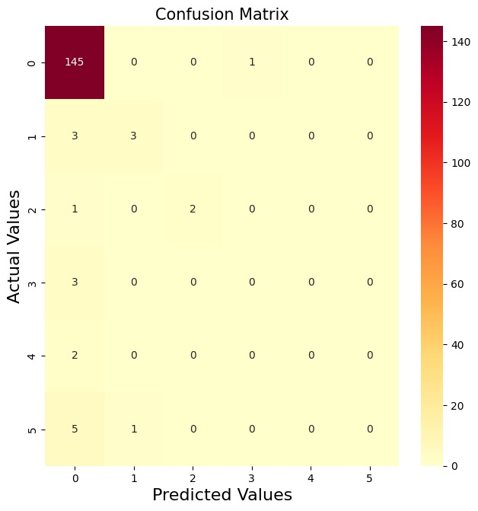
Confusion Matrix

Slide 16
Thank You

